Slide 1
DVCS with Mercurial
Confidential

Slide 2
Overview
What is DVCS?
Why Mercurial?
DirecTV Mercurial System.
Basic Commands.
Confidential

Slide 3
1. What is DVCS?
What is DVCS?
How does it work?
Confidential

Slide 4
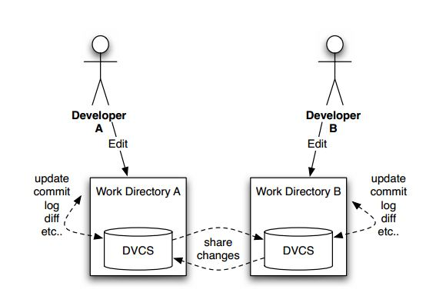

1.1. What is DVCS?
DVCS, a distributed version control system, are Version Control Systems where there is no central repository.
DVCS keeps track of software revisions and allows many developers to work on a given project independent of network access or a central server. Committing, branching and merging are fast.
DVCS takes a peer to peer approach, as opposed to the client-server approach of centralized systems. Rather than a single, central repository on which clients synchronize, each peer's working copy of the codebase is a bona-fide repository.
Confidential

Slide 5
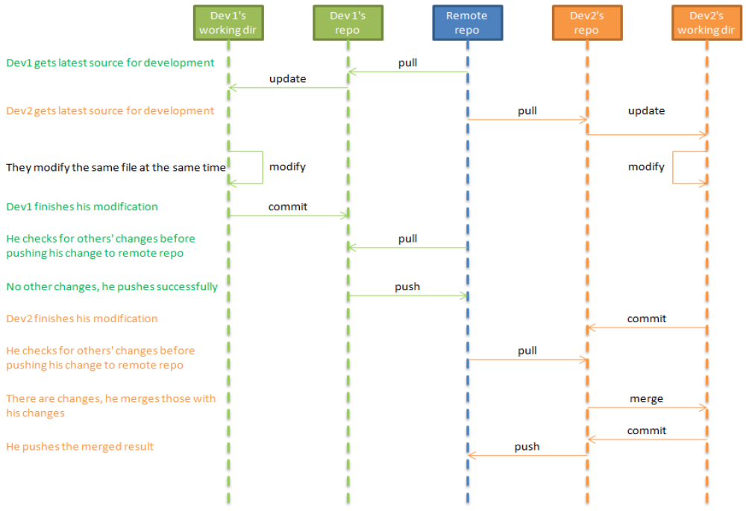
1.2. How does it work?
Confidential

Slide 6
2. Why Mercurial?
About Mercurial (hg).
Mercurial Features.
SVN vs Mercurial.
Confidential

Slide 7
2.1. About Mercurial (hg)
It is mainly implemented using the Python programming language, but includes a binary diff implementation written in C.
It is supported on MS Windows and Unix-like systems, such as FreeBSD, Mac OS X and Linux. Mercurial is primarily a command line program but graphical user interface extensions are available.
Mercurial uses SHA-1 hashes to identify revisions.
For repository access via a network, Mercurial uses an HTTP-based protocol that seeks to reduce round-trip requests, new connections and data transferred. Mercurial can also work over ssh where the protocol is very similar to the HTTP-based protocol.
By default it uses a 3-way merge before calling external merge tools.
Confidential

Slide 8
2.2. Mercurial Features
Pushing changes to another repository
Merging conflicting changes
Searching through history
Viewing repository through a web browser
Using Mercurial as a “super client” for Subversion
Commit selected diffs in checked files.
Undo (rollback) last immediate commit.
Visual Diff checked files.
Revert checked files to last revisioned state
Add checked files
Move checked files
Remove checked files
Forget checked files
Pull all changes from another repository into the current one
Push all changes from your repository into another one
Shelve changes when they not needed and get them back in future
Confidential

Slide 9
2.3. SVN vs Mercurial
SVN Limitations
DVCS/Mercurial Strengths
Branching is easy, but merging is painful
Active net connection required to interact
Unable to share changes with others without sharing with everyone (including the build server)
Fails to merge changes when something is renamed
.svn files are littered throughout your source tree
Branching is easy, merging is (relatively) easy
If your computer is on, you have access to the repository
Sharing changes with selected people is easy (hg serve/hg push/hg pull)
Aware of file history and can merge into renamed file
Single .hg directory at root of source tree
Confidential

Slide 10
2.3. SVN vs Mercurial (cont.)
SVN Limitations
DVCS/Mercurial Strengths
Slow over-the-wire performance
Discourages experimentation
Fast performance; you’re working on local filesystem
Cheap to create/throw away local experimental branch
Confidential

Slide 11
2.3. SVN vs Mercurial (cont.)
SVN Strengths
DVCS/Mercurial Limitations
Familiar to most developers
Relatively easy to grasp
Everyone knows where the trunk is because there’s only one server
Well established tool support and integration
There is a winner among free, centralized VCS systems: Subversion
Most developers will need to learn to think differently
Better understanding of version control concepts required
Need to define and adhere to convention to know where the trunk is
Tool support and integration isn’t quite as far along
DVCS systems are still new and a clear winner has not been established
Confidential

Slide 12
3. DirecTV Mercurial System.
Install Mercurial.
Some information about DTV project
Useful Extensions
Confidential

Slide 13

3.1. Install Mercurial
Fedora: sudo yum install mercurial
Ubuntu: sudo apt-get install mercurial
Create file ~/.hgrc
  Vim ~/.hgrc
  Add your checkin information:
    [ui]
    username= Cuong Tran <cuongtv@gcs-vn.com>
Clone source code from mercurial
  hg clone http://172.19.7.213:81/hg/druid
  hg clone ssh://hg@sweng-hg/druid
  (Incase Linux doesn't know sweng-hg:
  hg clone ssh://hg@10.23.161.93/druid)
Confidential

Slide 14
3.1. Install Mercurial (cont.)
To map hostnames to IP addresses:
  Add this below info into /etc/hosts
  10.23.161.93 sweng-hg.la.frd.directv.com sweng-hg
When we use ssh, it needs a pass-phase to access into mercurial
  Add your private key into: ~/.ssh/
  e.g: ls ~/.ssh/id_rsa
Link for refers:
  http://hgbook.red-bean.com/read/a-tour-of-mercurial-the-basics.html
  http://mercurial.selenic.com/wiki/QuickStart
Confidential

Slide 15
3.2. Some information about DTV project
Mercurial link of HDG: ssh://172.19.7.213/
Clone local mercurial (branch default):
  hg clone ssh://172.19.7.213/<component>
  e.g: hg clone ssh://172.19.7.213/druid
Clone US mercurial (branch default):
  hg clone ssh://hg@sweng-hg/<component>
  e.g: hg clone ssh://hg@sweng-hg/druid
Brand HMC30 (HR34):
  hg clone ssh://hg@10.23.161.93/hmc
Confidential

Slide 16
3.3. Useful Extensions
hgk – Graphical view of the change
  Install: yum install mercurial-hgk
  Enable: edit ~/.hgrc
  [extensions]
  hgext.hgview=
  Use: hg view
branchInfo – Display branch information
  Install: clone the devtools repo
  Enable:
  [extensions]
  branchInfo=[path to branchInfo.py script]
  Use: hg branchInfo
Confidential

Slide 17
4. Basic Commands
Confidential

Slide 18

4. Basic commands
help
clone
init
add/remove/addremove
cp/rename/mv
status
diff
commit
Confidential

Slide 19
4. Basic commands – Help!
hg help: General help
  List of commands
  List of extensions
  Additional help topics (advanced stuff)
hg help <command>
  hg <command> --help
E.g.:
  hg clone --help
  Hg pull --help
Confidential

Slide 20
4. Basic commands – Cloning a repository.
hg clone <remote> <foldername>
  Creates a .hg folder in <foldername>
  Downloads all the patches/commits from <remote>
  Checks out the files of the last commit on the default branch on your disk, in <foldername>
Confidential

Slide 21
4. Basic commands – Init: Creating a new repository.
hg init <foldername>
  Creates a .hg folder in <foldername>
  No commits yet
  No changes yet
Confidential

Slide 22
4. Basic commands – Add/Remove/Addremove.
hg add <path>
  'enables' <path> for committing
hg rm <path>
  'disables' <path> for committing
hg addremove <path>
  "Add all new files and remove all missing files from the repository."
  Use with care (.hgignore!)
Paths either absolute or relative to $PWD!
  <> 'hg status' output
Confidential

Slide 23
4. Basic commands – cp/rename/mv/move.
Avoid having to add/rm
  hg cp
  hg rename
    Aliases: mv, move
Confidential

Slide 24
4. Basic commands – Status.
Show which files are:
  Added (A)
  Removed (R)
  Modified (M)
  Missing (!) - use hg rm
  Not tracked (?) - use hg add
Paths relative to repository root (annoying)
  Try hg status .
  Mercurial 1.7 or higher:
    Alias: stat = !hg status $($HG root) $HG_ARGS
Confidential

Slide 25
4. Basic commands – Diff: what did I change?
hg diff
Changed files:
  Show diff with previously committed version
Added files:
  Show content
Removed files:
  Show content
Specify <path>
  Diff only that file/those files
  Can use re: and glob:
USE COLOR !!!
Confidential

Slide 26
4. Basic commands – Commit: Create a new commit.
hg commit
  Username
    from .hgrc (preferably!)
    -u “Cuong Tran <cuongtv@gcs-vn.com>"
  Commit message
    in editor (default)
    -m "My message"
  Files
    Default: everything shown as A/R/M in status
    Use -I and -X for more control (re, glob)
Creates a new commit
Use nice commit messages
Confidential

Slide 27
4. Basic commands - Example
Clone repo
  hg clone ssh://hg@10.23.161.95/druid
Pull from remote
  hg pull
Update remote to local
  hg update / hg up
Commit source code to local repo
  hg commit / hg ci
Push change from local repo to remote
  hg push [remote_path]
Confidential

Slide 28
4. Basic commands – Example (cont.)
Create new named branch
  hg branch “branch name”
  hg ci
  hg push [remote path] --new-branch
Merge changeset between branch
  hg up [changeset need to be merged]
  hg merge [changeset to merge]
Compare changeset
  hg diff -r[changeset_1] -r[changeset_2]
View repo log
  hg view (need hgk extension)
  hg log
Confidential

